Slide 1
ABC Warehouse Alarm Client Software Report
Mike Zeen, Dec, 14, 2018

Slide 2
Contents
1. Alarm client 1.0 – Work Report
2. Alarm client 2.0 – Plan

Slide 3
1. Alarm client1.0 – Work Report 1.1 Architecture
Alarm API and Viewer
Webapp
Webapp-manager
Setup
Django 1.8
PyInstaller
C# WebForm
Inno
Python 3.7.1
.NET Platform 4.7

Slide 4
1. Alarm client1.0 – Work Report 1.2 Deployment Procedure
Python
.NET Platform
webapp
Alarm API
Alarm Viewer
Converting from python to exe
Django WSGI server
PyInstaller
Webapp
Inno
Setup
Webapp-manager
Ubuntu
It’s still not done. It will done in 2.0
C# Windows Form App

Slide 5
1. Alarm client1.0 – Work Report 1.3 Webapp Packages
1. Django – Alarm RESTFUL API and Viewer (UI)
WSGI webserver is embedded into the webapp and now it runs the RESTFUL API and Viewer. First time I planned to use Kivy framework to build Viewer (UI) as GUI to be able run on cross-platform, but I implemented as web because all systems have web browser.
2. SQLite – Local Database (embedded RDBMS) to save alarms
3.Plyer notification – Show system notification as balloon window
4. PyInstaller – Converting Python files to windows execute files can be run without python

Slide 6
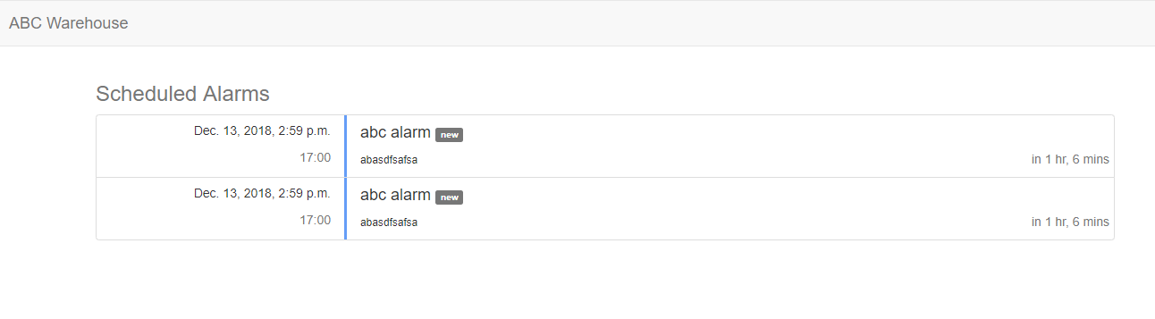
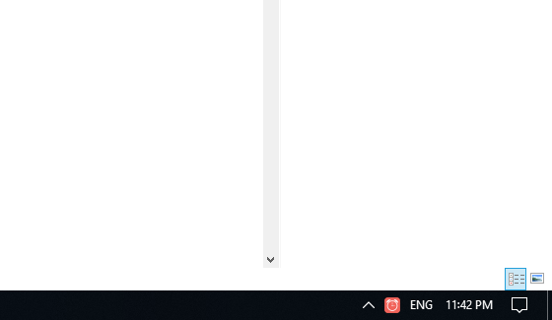
Alarm client1.0 – Work Report 1.4 Webapp-manager
Webapp-manager is made by c# and it starts/stops WSGI server as daemon that run alarm API and viewer as well as have other menus to guide for users.
Server Damon
API (POST) http://{ip}/abcalarm/alarm
View Alarms
Stop / Start
Exit

Slide 7
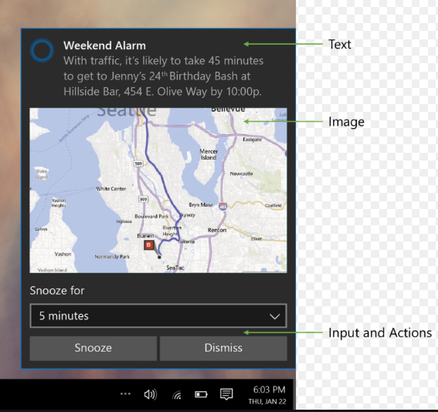
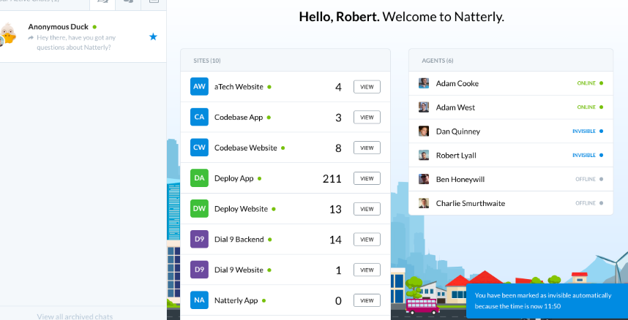
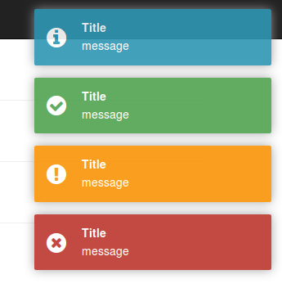
2. Alarm client1.0 – Plan 2.1 Alarm viewer upgrade
1. Windows notification style – now it’s using simple notification style with only title, text and icon. I can upgrade it with image and “Dismiss” button.
2. Alarm viewer will be refresh automatically to upgrade notification list.
3. Alarm viewer UI/UX tech will be upgraded using React or Angular
4. GUI Desktop app will be also considered.

Slide 8
2. Alarm client1.0 – Plan 2.2 FTP automatic upgrade function
Alarm client webapp-manager will include FTP upgrade function. So that every stores using this alarm client software will keep latest version software always.
The FTP upgrade core module could be developed by python and interface (a menu) could be developed per platform.

Slide 9
2. Alarm client1.0 – Plan 2.3 Linux version deployment
Ubuntu version installation .deb file will be made by PyInstaller and dpkg.
Ubuntu system notification will be tested by Plyer and will be made as much as possible to be same with windows notification.
Ubuntu version webapp-manager will be developed by shell script or python.

Slide 10
2. Alarm client1.0 – Plan 2.4 Windows Installation upgrade
Next version windows installation setup.exe file could be upgraded with ABCWarehouse banner and ico files.
It could be involved ABCWarehouse certification file.

Slide 11
2. Alarm client1.0 – Plan 2.5 Automatic startup with OS
Now installation package is running webapp-manager bootloder after done it’s installation. This bootloader will have a function to startup with Operating System even it’s Ms-windows or Linux.

Slide 12
2. Alarm client1.0 – Plan 2.6 Other resources will be upgraded
Other graphic design result will be added and upgraded as more professional.
.ico, .png, .jpg

Slide 13
2. Alarm client1.0 – Plan 2.7 Alarm server tester for client testing
stores.abcwarehouse.com website could have new page for testing or real alarm issue or management.
Server-side Functions:
1. client ip address management tab (add or remove or edit)
2. alarm add/remove/edit/send

Slide 14
THANK YOU

